Slide 1

The Cortana Intelligence Suite
Microsoft R for the SQL Professional – Planning, Setup and Environment
Microsoft Machine Learning and Data Science Team
CortanaIntelligence.com
Notes:
Main page: http://cortanaanalytics.com
To begin this module, you should have:
Basic Math and Stats skills
Business and Domain Awareness
General Computing Background
NOTE: These workbooks contain many resources to lead you through the course, and provide a rich set of references that you can use to learn much more about these topics. If the links do not resolve properly, type the link address in manually in your web browser. If the links have changed or been removed, simply enter the title of the link in a web search engine to find the new location or a corollary reference.

Slide 2
Welcome!
Log in to the site:
http://cisw-foundations.azurewebsites.net/
Select the “The Cortana Intelligence Suite – Foundations (Course Materials)” Link
Click the “Course Materials” button, and then “Sign in…”
Open “Edit in Browser”, Find the “R For T-SQL” tab, Enter your primary role at your company on the sign-in sheet.

Slide 3

Learning Objectives
Understand the R Language and where it is used
Understand the Microsoft R Platform and its capabilities
Set up and use the server and various client tools for a R environment
Notes:
At the end of this Module, you will:
Understand the R Language and where it is used
Understand the Microsoft R Platform and its capabilities
Set up and use the server and various client tools for a R environment

Slide 4
The Data Science Process and Platform

Slide 5
The Team Data Science Process
Business Understanding
Define Objectives
Identify Data Sources
Data Acquisition and Understanding
Ingest Data
Explore Data
Modeling
Feature Selection
Create and Train Model
Deployment
Customer Acceptance
Operationalize
Testing and Validation
Update Data
Handoff
Re-train and re-score
Notes:
This process largely follows the CRISP-DM model: http://www.sv-europe.com/crisp-dm-methodology/
It also references the Cortana Intelligence process: https://azure.microsoft.com/en-us/documentation/articles/data-science-process-overview/
A complete process diagram is here: https://azure.microsoft.com/en-us/documentation/learning-paths/cortana-analytics-process/
Some walkthrough’s of the various services: https://azure.microsoft.com/en-us/documentation/articles/data-science-process-walkthroughs/
An integrated process and toolset allows for a more close-to-intent deployment
Iterations are required to close in on the solution – but are harder to management and monitor
Data Science Blog: https://buckwoody.wordpress.com/

Slide 6
The Cortana Intelligence Platform
Cortana, Cognitive Services, Bot Framework
Power BI
HDInsight
Stream Analytics
Azure Machine Learning (MRS)
SQL Data Warehouse (SQL DB, Document DB)
Data Lake
Event Hubs
Data Factory
Data Catalog
Microsoft Azure
Notes:
Platform and Storage: Microsoft Azure – http://microsoftazure.com Storage: https://azure.microsoft.com/en-us/documentation/services/storage/ (Host It)
Azure Data Catalog: http://azure.microsoft.com/en-us/services/data-catalog (Doc It)
Azure Data Factory: http://azure.microsoft.com/en-us/services/data-factory/ (Move It)
Azure Event Hubs: http://azure.microsoft.com/en-us/services/event-hubs/ (Bring It)
Azure Data Lake: http://azure.microsoft.com/en-us/campaigns/data-lake/ (Store It)
Azure DocumentDB: https://azure.microsoft.com/en-us/services/documentdb/ , Azure SQL Data Warehouse: http://azure.microsoft.com/en-us/services/sql-data-warehouse/ (Relate It)
Azure Machine Learning: http://azure.microsoft.com/en-us/services/machine-learning/ (Learn It)
Azure HDInsight: http://azure.microsoft.com/en-us/services/hdinsight/ (Scale It)
Azure Stream Analytics: http://azure.microsoft.com/en-us/services/stream-analytics/ (Stream It)
Power BI: https://powerbi.microsoft.com/ (See It)
Cortana: http://blogs.windows.com/buildingapps/2014/09/23/cortana-integration-and-speech-recognition-new-code-samples/ and https://blogs.windows.com/buildingapps/2015/08/25/using-cortana-to-interact-with-your-customers-10-by-10/ and https://developer.microsoft.com/en-us/Cortana (Say It)
Cognitive Services: https://www.microsoft.com/cognitive-services
Bot Framework: https://dev.botframework.com/
All of the components within the suite: https://www.microsoft.com/en-us/server-cloud/cortana-intelligence-suite/what-is-cortana-intelligence.aspx
What can I do with it? https://gallery.cortanaintelligence.com/
Getting Started Quickly: https://caqs.azure.net/#gallery

Slide 7
The R Ecostructure
Notes:
Video Introduction to R: https://mran.revolutionanalytics.com/documents/what-is-r/

Slide 8

R
Open Source “lingua franca”
Global Community
Ecosystem
Can be Scaled to Big Data,
Big Analytics
Analytics, Computing, Modeling
Millions of users
7000+ Algorithms, Test Data & Evaluations
Scalability
Notes:
One-Page R: https://togaware.com/onepager/
R on Youtube: https://www.youtube.com/user/thelearnr
R Links: http://www.datasciencecentral.com/m/discussion?id=6448529%3ATopic%3A280135
R resources: https://msdn.microsoft.com/en-us/microsoft-r/microsoft-r-more-resources

Slide 9
SQL
SQL and R Contrasted
R
Client/Server
Database Objects
DML, DDL
DCL
Declarative Code
Interactive Environment
Data Structures
Functions
Libraries (Packages)
Functional Code Flow
Notes:
Learn SQL: http://www.w3schools.com/SQl/default.asp
Try R, with a great interface. http://tryr.codeschool.com/levels/1/challenges/22
R and Statistics Intro: https://www.youtube.com/watch?v=xb5P5xdcr2U&feature=youtu.be&a
R Online: http://www.tutorialspoint.com/r_terminal_online.php
Using R to explore data: http://www.analyticsvidhya.com/blog/2015/10/cheatsheet-11-steps-data-exploration-with-codes/
Quick R Intro: http://www.datasciencecentral.com/m/blogpost?id=6448529%3ABlogPost%3A112754
Creating a recommender engine in R: http://www.analyticbridge.com/profiles/blogs/build-basic-recommendation-engine-using-r
Visualizations cheat-sheet in R: http://www.datasciencecentral.com/forum/topics/cheat-sheet-data-visualization-with-r?groupUrl=tutorials
Data Science Blog: https://buckwoody.wordpress.com/

Slide 10



Lab:
Account Activation
VM Setup
Workstation Setup
Notes:
If you do not have a Microsoft Azure account, go here: https://azure.microsoft.com/en-us/free/ (You will need a credit card, but you will not be charged)
Log in to the Azure Portal: https://ms.portal.azure.com
Create a new Windows Data Science Virtual Machine (2 Processors, 7GB RAM, HDD): https://azure.microsoft.com/en-us/documentation/articles/machine-learning-data-science-vm-do-ten-things/
Optional, if using your local machine:
Install SQL Server 2016 and ensure you select R Services – see this link: https://www.microsoft.com/en-us/cloud-platform/sql-server-editions-developers
Install Visual Studio Community Edition 2015: https://www.microsoft.com/en-us/download/details.aspx?id=48146
Install SQL Server Data Tools: https://docs.microsoft.com/en-us/sql/ssdt/download-sql-server-data-tools-ssdt
Install R Tools for Visual Studio: https://microsoft.github.io/RTVS-docs/

Slide 11
The Microsoft R Platform
Notes:
Primary Microsoft R Site: https://msdn.microsoft.com/en-us/microsoft-r/index

Slide 12
Microsoft R Products
Microsoft R Open
SQL Server R Services
Free and open source R distribution
Built in Advanced Analytics and Stand Alone Server Capability
Enhanced and distributed by Revolution Analytics
Leverages the Benefits of SQL 2016 Enterprise Edition
Microsoft R Server for Redhat Linux
Microsoft R Server for SUSE Linux
Microsoft R Server for Teradata DB
Microsoft R Server for Hadoop on Redhat
Microsoft R Server
Notes:
Channel 9 videos on Microsoft R: https://channel9.msdn.com/Search?term=Microsoft%20R#lang-en=en&ch9Search

Slide 13

Microsoft R Open
Enhanced Open Source R distribution
Based on the latest Open Source R
Built, tested and distributed by Microsoft
Enhanced by Intel MKL Library to speed up linear algebra functions
Compatible with all R-related software
CRAN packages, RStudio, third-party R integrations, …
Revolutions Open-Source R packages
Reproducible R Toolkit – checkpoint
MRAN website mran.revolutionanalytics.com
Enhanced documentation and learning resources
Discover 7500 free add-on R packages
Open source (GPLv2 license) - 100% free to download, use and share
Notes:
Quick Video on R Client: https://channel9.msdn.com/blogs/MicrosoftR/Microsoft-Introduces-new-free-Microsoft-R-Client

Slide 14
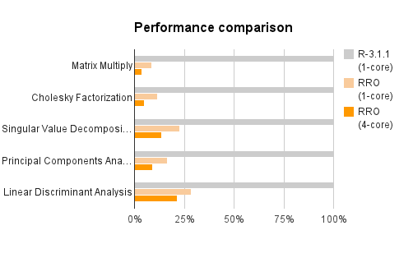
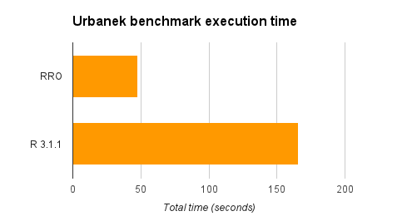
CRAN R compared to Microsoft R Open
Matrix calculation – up to 27x faster
Matrix functions – up to 16x faster
Programation – 0x faster
More efficient and multi-threaded math computation.
Benefits math intensive processing.
No benefit to program logic and data transform
Notes:
Overview: https://channel9.msdn.com/Series/Microsoft-R-Server-Series/Introduction-to-Microsoft-R-Server-Session-1--Overview

Slide 15
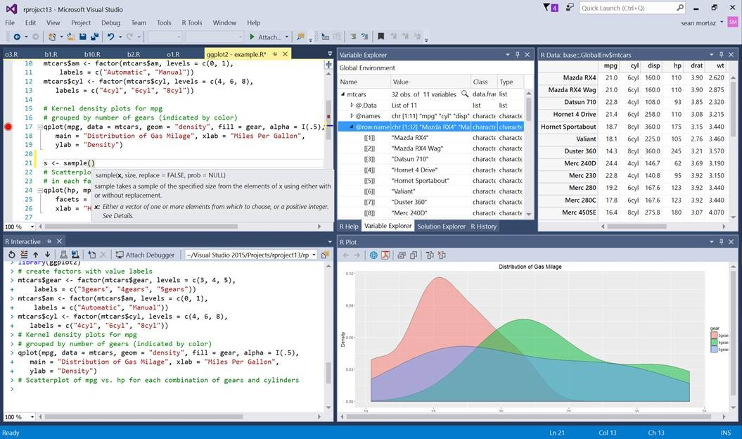
Microsoft R Open and R Client
Microsoft R Server
ScaleR
Notes:
Book and Series: http://dacrook.com/introduction-to-microsoft-r-open/
Microsoft R Client: https://msdn.microsoft.com/en-us/microsoft-r/index#mrc
Data Science Blog: https://buckwoody.wordpress.com/

Slide 16
Microsoft R Components
CRAN R
Microsoft R Open
Microsoft R Client
Microsoft R Server
HDInsight SparkR / SQL Server R Services
R in Azure Machine Learning
Notes:
Supported Platforms for Microsoft R Server: https://msdn.microsoft.com/en-us/microsoft-r/rserver-install-supported-platforms
Book and Series: http://dacrook.com/introduction-to-microsoft-r-open/
Microsoft R Client: https://msdn.microsoft.com/en-us/microsoft-r/index#mrc
Microsoft R Server: https://msdn.microsoft.com/en-us/microsoft-r/index#mrs
SQL Server R Services: https://msdn.microsoft.com/en-us/microsoft-r/index#sqlr
HDInsight SparkR: https://azure.microsoft.com/en-gb/services/hdinsight/apache-spark/
Data Science Blog: https://buckwoody.wordpress.com/

Slide 17
Microsoft R Server
Microsoft R Server is a broadly deployable enterprise-class analytics platform based on R that is supported, scalable and secure. Supporting a variety of big data statistics, predictive modeling and machine learning capabilities, R Server supports the full range of analytics – exploration, analysis, visualization and modeling
High-performance open source R plus:
Data source connectivity to big-data objects
Big-data advanced analytics
Multi-platform environment support
Inpredictive modeling
Development and production environment support
IDE for data scientist developers
Secure, Scalable R Deployment
ConnectR
R Open
R Server
ScaleR
R+CRAN
RSR Connector
DistributedR
Open Source Components
Licensed Components
Notes:
Microsoft R Server: https://msdn.microsoft.com/en-us/microsoft-r/index#mrs

Slide 18
The Microsoft R Server Platform
R+CRAN
Open source R interpreter
R 3.2.2
Freely-available huge range of R algorithms
Algorithms callable by MSR
Embeddable in R scripts
100% Compatible with existing R scripts, functions and packages
R Open Microsoft R Server
ConnectR
ConnectR
High-speed & direct connectors
Available for:
High-performance XDF
SAS, SPSS, delimited & fixed format text data files
Hadoop HDFS (text & XDF)
Teradata Database & Aster
EDWs and ADWs
ODBC
R+CRAN
RSR Connector
ScaleR
DistributedR
ScaleR
Ready-to-Use high-performance big data big analytics
Fully-parallelized analytics
Data prep & data distillation
Descriptive statistics & statistical tests
Range of predictive functions
User tools for distributing customized R algorithms across nodes
Wide data sets supported – thousands of variables
MRO
Performance enhanced R interpreter
Based on open source R
Adds high-performance math library to speed up linear algebra functions
DistributedR
Distributed computing framework
Delivers cross-platform portability
Notes:
Installing on Linux: https://channel9.msdn.com/Series/Microsoft-R-Server/Microsoft-R-Server-Installation-Linux

Slide 19

CRAN, MRO, MRS Comparison
Microsoft
R Open
Microsoft
R Server
Datasize | In-memory | In-memory | In-Memory or Disk Based
Speed of Analysis | Single threaded | Multi-threaded | Multi-threaded, parallel processing 1:N servers
Support | Community | Community | Community + Commercial
Analytic Breadth & Depth | 7500+ innovative analytic packages | 7500+ innovative analytic packages | 7500+ innovative packages + commercial parallel high-speed functions
License | Open Source | Open Source | Commercial license. Supported release with indemnity
Notes:
Technology Overview: https://channel9.msdn.com/Series/Microsoft-R-Server/Technology-Overview-for-Microsoft-R-Server-2016

Slide 20

CRAN R
MRO
MRS
Adds multithreaded computation for linear algebra
MRS Packages
doRSR
RevoIOQ
RevoMods
RevoPemaR
RevoRpeConnector
RevoRsrConnector
RevoScaleR
RevoTreeView
RevoUtils
Adds functions and infrastructure for scalable computation over local and distributed platforms
Makes it easy to share R code and replicate results using specific R package versions.
MRO Packages
checkpoint (also on CRAN)
RevoUtilsMath (for MKL)
MRO Packages
checkpoint (also on CRAN)
RevoUtilsMath (for MKL)
Standard Packages
base
recommended
Standard Packages
base
recommended
Standard Packages
base
recommended
BLAS / LAPACK - Standard
BLAS / LAPACK – Intel MKL
BLAS / LAPACK – Intel MKL
Kernel
Kernel
Kernel
Notes:
Getting Started: https://msdn.microsoft.com/en-us/microsoft-r/?f=255&MSPPError=-2147217396

Slide 21
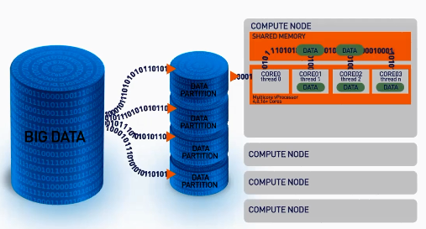
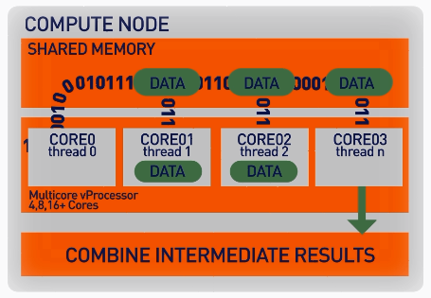
ScaleR – Parallel + “Big Data”
ScaleR algorithms work inside multiple cores / nodes in parallel at high speed
Stream data in to RAM in blocks. “Big Data” can be any data size. Handle Megabytes to Gigabytes to Terabytes…
Interim results are collected and combined analytically to produce the output on the entire data set
XDF file format is optimised to work with the ScaleR library and significantly speeds up iterative algorithm processing.
Notes:
Function Breakdown: https://msdn.microsoft.com/en-us/microsoft-r/scaler/scaler

Slide 22

Scale R – Parallelized Algorithms & Functions
Data Preparation
Statistical Tests
Variable Selection
Data import – Delimited, Fixed, SAS, SPSS, OBDC
Variable creation & transformation
Recode variables
Factor variables
Missing value handling
Sort, Merge, Split
Aggregate by category (means, sums)
Chi Square Test
Kendall Rank Correlation
Fisher’s Exact Test
Student’s t-Test
Stepwise Regression
Simulation
Sampling
Simulation (e.g. Monte Carlo)
Parallel Random Number Generation
Subsample (observations & variables)
Random Sampling
Cluster Analysis
Descriptive Statistics
Predictive Models
Min / Max, Mean, Median (approx.)
Quantiles (approx.)
Standard Deviation
Variance
Correlation
Covariance
Sum of Squares (cross product matrix for set variables)
Pairwise Cross tabs
Risk Ratio & Odds Ratio
Cross-Tabulation of Data (standard tables & long form)
Marginal Summaries of Cross Tabulations
K-Means
Sum of Squares (cross product matrix for set variables)
Multiple Linear Regression
Generalized Linear Models (GLM) exponential family distributions: binomial, Gaussian, inverse Gaussian, Poisson, Tweedie. Standard link functions: cauchit, identity, log, logit, probit. User defined distributions & link functions.
Covariance & Correlation Matrices
Logistic Regression
Classification & Regression Trees
Predictions/scoring for models
Residuals for all models
Classification
Decision Trees
Decision Forests
Gradient Boosted Decision Trees
Naïve Bayes
Combination
rxDataStep
rxExec
PEMA-R API Custom Algorithms
Notes:
SQL Server Implementation of ScaleR Functions: https://msdn.microsoft.com/en-us/library/mt652103.aspx

Slide 23
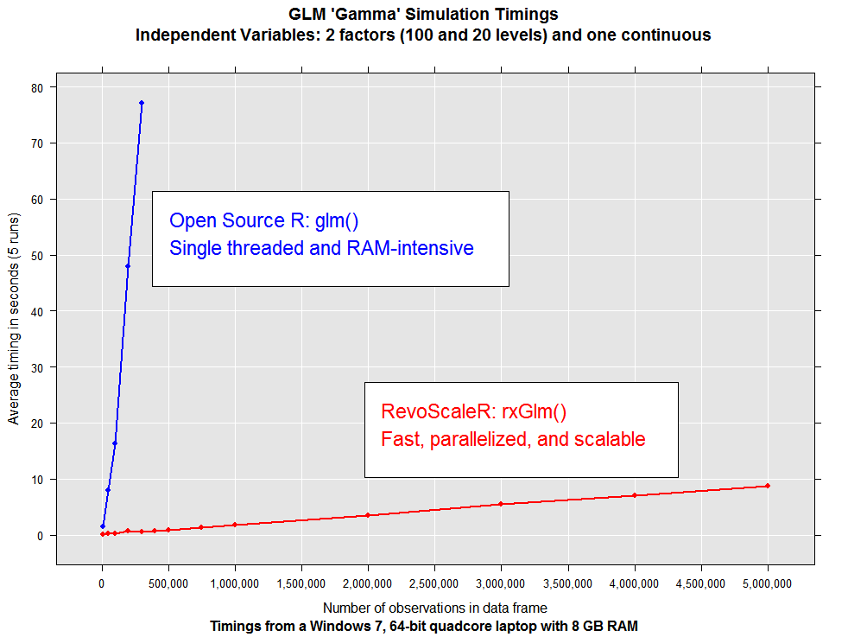
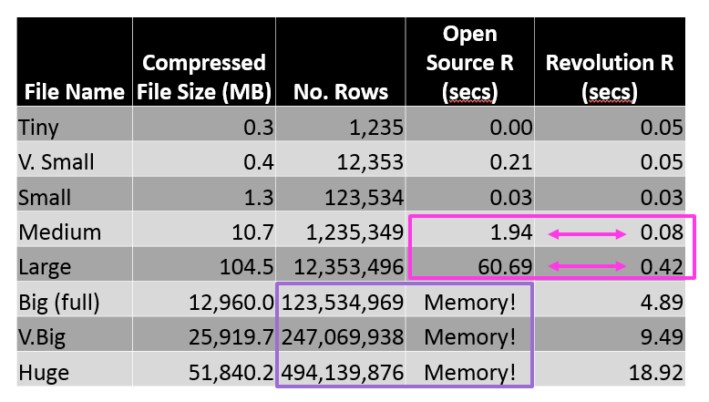
ScaleR - Performance comparison
Microsoft R Server has no data size limits in relation to size of available RAM. When open source R operates on data sets that exceed RAM it will fail. In contrast Microsoft R Server scales linearly well beyond RAM limits and parallel algorithms are much faster.
US flight data for 20 years
Linear Regression on Arrival Delay
Run on 4 core laptop, 16GB RAM and 500GB SSD
Notes:
ScaleR Functions for Working with SQL Server Data: https://msdn.microsoft.com/en-us/library/mt732681.aspx

Slide 24
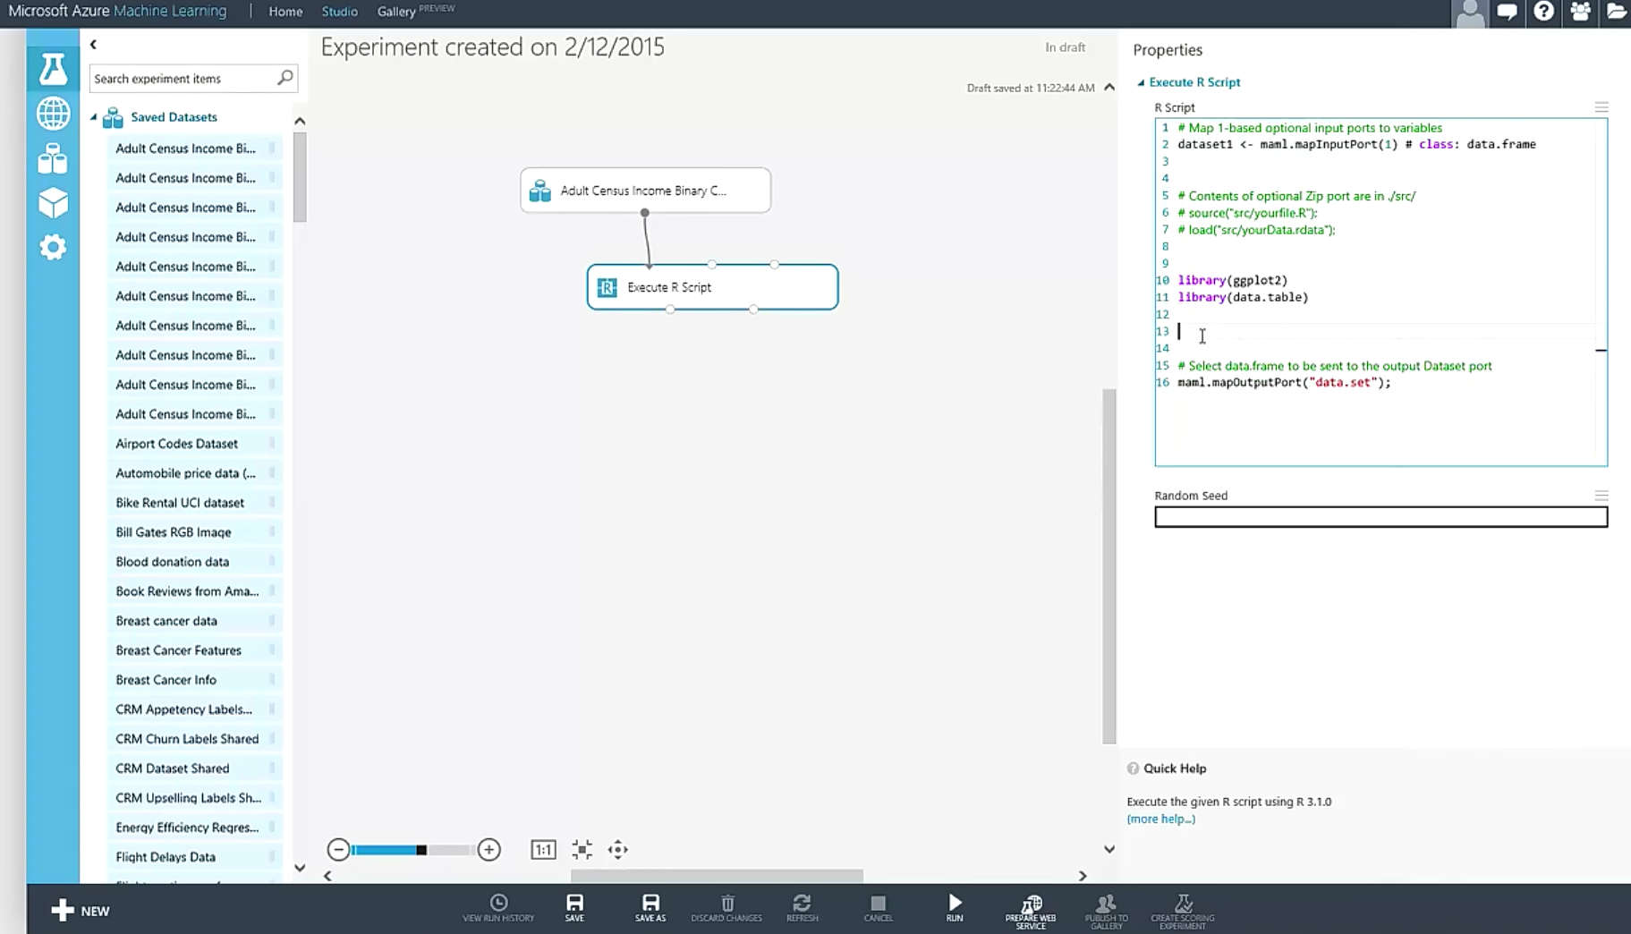
R in Azure Machine Learning
Dataset1 <-maml.mapInputPort(1) # class:data.frame
Notes:
Primary reference: https://msdn.microsoft.com/en-us/library/dn905952.aspx
Using R in Azure Machine Learning: https://azure.microsoft.com/en-us/documentation/articles/machine-learning-r-quickstart/
Overview Video: https://channel9.msdn.com/Blogs/Windows-Azure/R-in-Azure-ML-Studio
R Packages supported: https://msdn.microsoft.com/en-us/library/mt741980.aspx
Data Science Blog: https://buckwoody.wordpress.com/

Slide 25
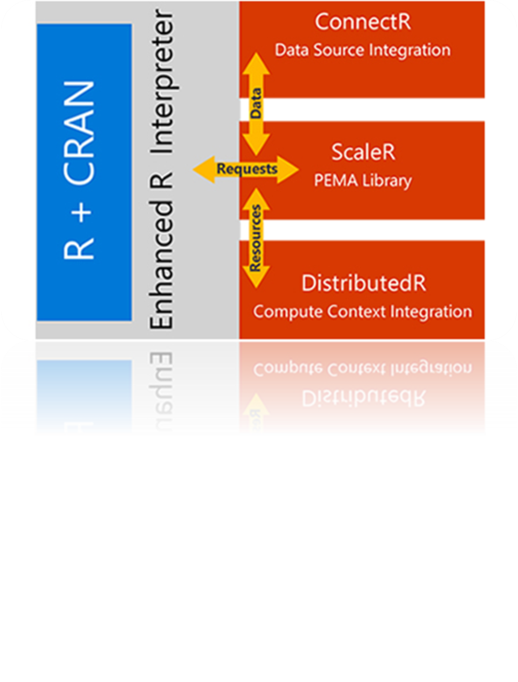
Spark HDInsight Cluster
Core Hadoop
Data processing
Microsoft integration
Data Movement
Packages
Pipeline / workflow
(Oozie)
JavaScript
C#, F#, .NET
(Zoo)
SparkR
Data Integration
(ODBC / SQOOP/ REST)
Relational
(SQL Server)
Metadata
(HCatalog)
PDW Polybase
Real Time Processing (Storm)
NoSQL Database
(HBase)
Scripting
(Pig)
Query
(Hive)
Event Driven Processing
Distributed Processing
(MapReduce)
Event Pipeline
(Event Hub/ Flume)
Business Intelligence
(Excel, Power View, SSAS)
YARN
Distributed Storage (HDFS)
Monitoring & Deployment (System Center)
World's Data (Azure Data Marketplace)
Azure Storage Vault (ASV)
Active Directory (Security)
Notes:
Full training example for the local HDP Instance: http://hortonworks.com/hadoop-tutorial/hello-world-an-introduction-to-hadoop-hcatalog-hive-and-pig/
More detail on the Hadoop Components: http://www.datasciencecentral.com/profiles/blogs/hadoop-herd-when-to-use-what

Slide 26

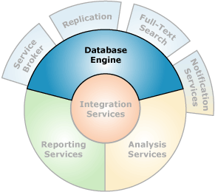
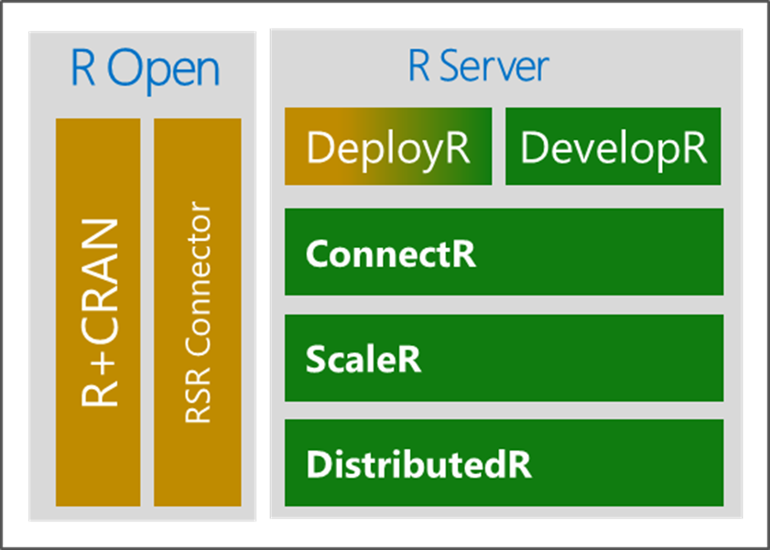

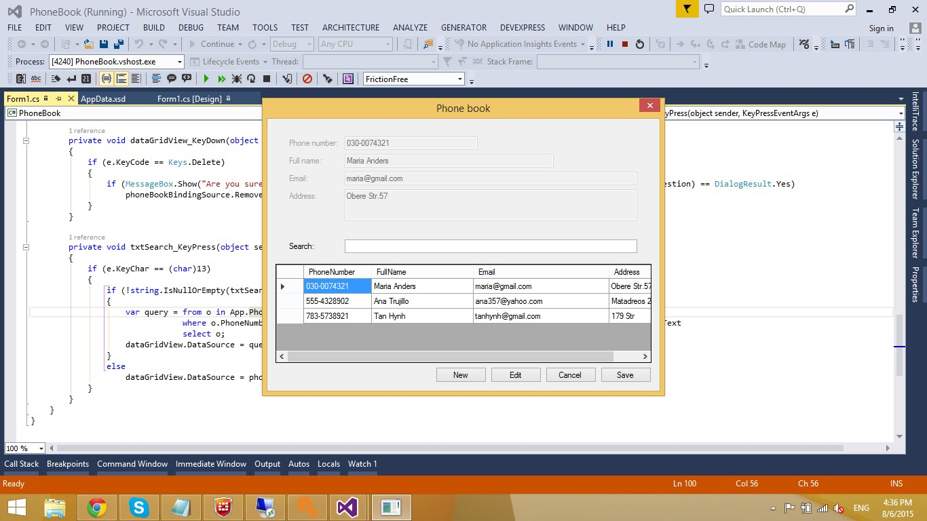
Microsoft R in SQL Server
Microsoft R Server
Launchpad
(BxlServer and SQL Satellite, Rserver.dll)
Notes:
Primary Documentation and training: https://msdn.microsoft.com/en-us/library/mt604845.aspx
Data Science Blog: https://buckwoody.wordpress.com/

Slide 27
R Client Options
Notes:
The Microsoft R Client: https://msdn.microsoft.com/en-us/microsoft-r/install-r-client-windows

Slide 28
Microsoft R Development Tools
Command-Line
RStudio
R Tools for Visual Studio (RTVS)
SQL Server tools
Notes:
Installing Microsoft R Client on Windows: https://msdn.microsoft.com/en-us/microsoft-r/install-r-client-windows
Files located at: C:\Program Files\Microsoft\R Client\R_SERVER\bin
Data Science Blog: https://buckwoody.wordpress.com/

Slide 29
The R Environment
Profiles
Version Control
Package Locations
Workspaces
Notes:
Note: “Environment” has a specific meaning in R – we are using the general term environment to mean the operating surroundings for your computer running R - http://adv-r.had.co.nz/Environments.html#env-basics
Information on the R Profiles: https://www.r-bloggers.com/fun-with-rprofile-and-customizing-r-startup/
Data Science Blog: https://buckwoody.wordpress.com/

Slide 30
Lab:
Install and Configure Client Environments
Query and set environment variables
Notes:
Open Visual Studio, and read through the walkthrough of the RTVS tools for SQL Server and R: https://microsoft.github.io/RTVS-docs/sqlserver.html
Download the Resources zip file as described by your instructor and extract all the files to a local directory on your system.
Open the file R for SQL Professionals Lab (Student).R and complete all exercises in #1.0 Planning, setup and environment. Look for three # symbols for the tasks you should complete. Work through all exercises and stop at #1.4 Package Management.

Slide 31
R Package Management
Notes:
Video Introduction to R: https://mran.revolutionanalytics.com/documents/what-is-r/

Slide 32
Packages
Use
Adding
Querying
Considerations
Notes:
Packages: http://www.dummies.com/programming/r/how-to-install-load-and-unload-packages-in-r/ and https://cran.r-project.org/doc/manuals/R-admin.html#Add_002don-packages
Book on Creating your own Packages: http://r-pkgs.had.co.nz/
A useful set of packages: https://support.rstudio.com/hc/en-us/articles/201057987-Quick-list-of-useful-R-packages
R Packages supported by Azure Machine Learning: https://msdn.microsoft.com/en-us/library/mt741980.aspx
R Package Management for SQL Server R Services: https://msdn.microsoft.com/en-us/library/mt790486.aspx
Scaling Packages: https://msdn.microsoft.com/en-US/library/mt637368.aspx
Data Science Blog: https://buckwoody.wordpress.com/

Slide 33
Lab:
Evaluate, determine and apply packages to various workloads
Notes:
Open the file R for SQL Professionals Lab (Student).R and complete #1.4 Package Management.
Check to see if the following packages are installed:
dplyr
tidyr
lubridate
ggplot2
xtable
maps
zoo
knitr
If any of these are not installed, install them
Open the help for each of these libraries and work through one sample

Slide 34
Understand the R Language and where it is used
Understand the Microsoft R Platform and its capabilities
Set up and use the server and various client tools for a R environment
Notes:
Questions?
More resources:
https://msdn.microsoft.com/en-us/microsoft-r/microsoft-r-more-resources
Revolutions Blog
Blog: Joseph Sirosh, “Making R the Enterprise Standard…”
Getting Started with Microsoft R
Diving In.. Data Analysis in Microsoft R
R Server Technology – Video
R Tools for Visual Studio Sneak Peek
R Tools for Visual Studio Overview
SQL R Services Overview – Youtube
SQL R Services Feature Overview - Youtube
SQL R Services Overview at Build
SQL R Services Tutorial

